Slide 1
Boeing India University Relations
Industry Ready Engineer - Critical Design Reviews (CDR)
Underwing Payload Hardpoint for MALE UAV
August 2024

Slide 2
Project Stakeholders
Primary Stakeholders | Secondary Stakeholders | Internal Stakeholders
Customers Indian Airforce Indian Navy Indian Army other armed forces, local and global. Roles of Primary Stakeholders: End-Users. Strategic Planners. Collaborators. Responsibilities of Primary Stakeholders: Requirement Definition: Testing and Evaluation: Training and Integration into existing platforms: Operational Feedback | Regulatory Bodies DGCA Ministry of Defence Roles Regulator. Strategic Planner.. Oversight Authority. Responsibilities: Regulatory Compliance and Airspace Management. Safety Oversight and Inter-Agency Coordination: Suppliers Machining services Electronic wiring/connectors Sensors Roles of Suppliers: Component Manufacturers. System Integrators. Service Providers. Responsibilities of Suppliers: Quality and Standards Compliance. Timely Delivery. Supply Chain Management and Collaboration and Communication. | Boeing India Private Limited R.V. College of Engineering Roles: Conduct research and development. Provide innovative solutions and technical expertise. Responsibilities: Research. Development. Collaboration. Product Team Requirements Team Design Team Analysis Team Verification Team Roles of the Product Team: Product Manager and Systems Engineer. Design Engineers and Quality Assurance Engineer. Responsibilities of the Product Team: Requirement Analysis. Product Design and Development. Systems Integration and Testing, Validation Quality Assurance.

Slide 3
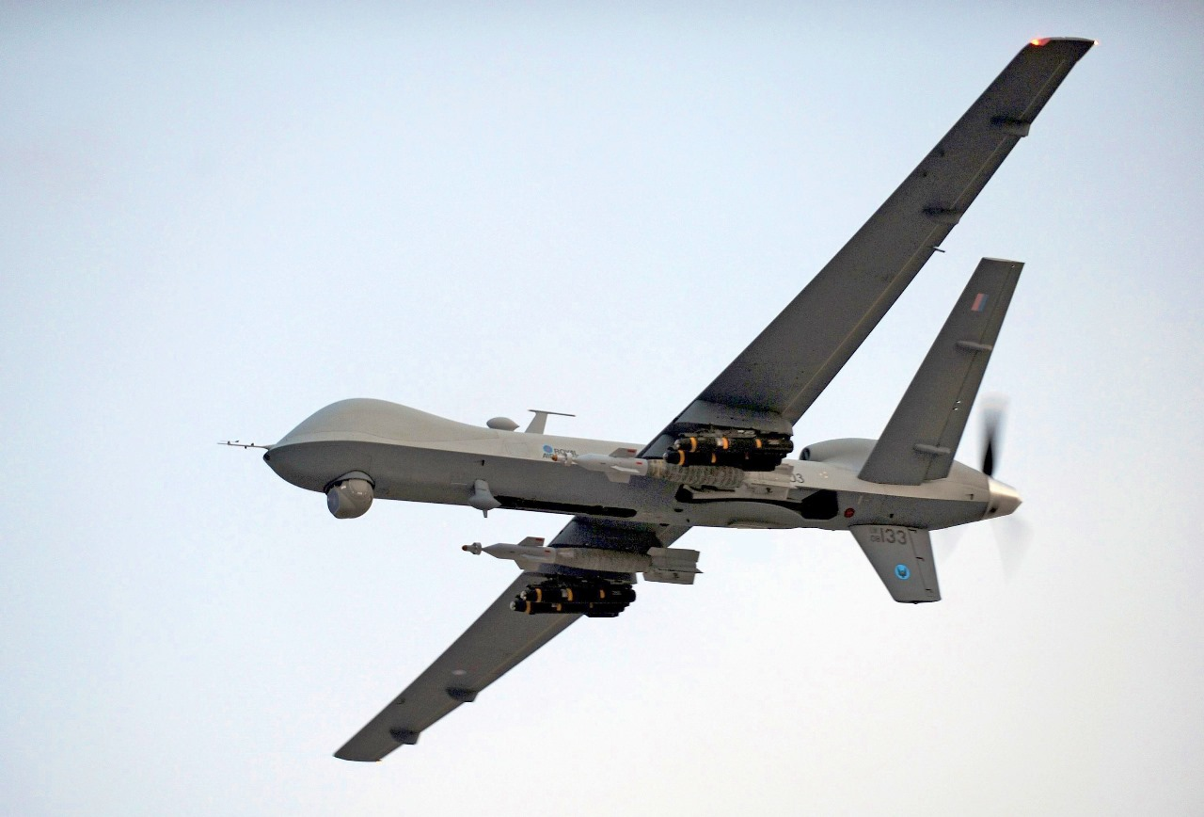
Project Overview

Slide 4
Project Objective
Create a robust, modular, and aerodynamically optimized hardpoint to enhance the MALE UAV’s capability to carry and deploy diverse payloads.
Establish a unified understanding of the project’s objectives, scope, and architecture among stakeholders.
Guide the development process with specific system requirements and safety assessments, adhering to SAE ARP4745A guidelines.
Address functional requirements including customer, operational, performance, and interface needs.
Mitigate risks, assure quality, ensure regulatory compliance, and provide a basis for thorough testing and validation.
Achieve a structured, efficient, and successful project execution.

Slide 5
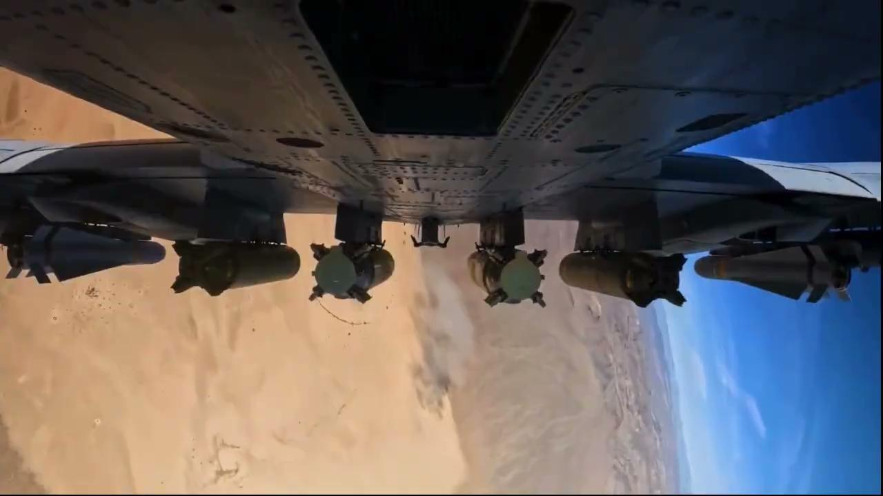
Project Objective
Payload Ejection
*Source: 422nd Test & Evaluation Squadron Social Media

Slide 6
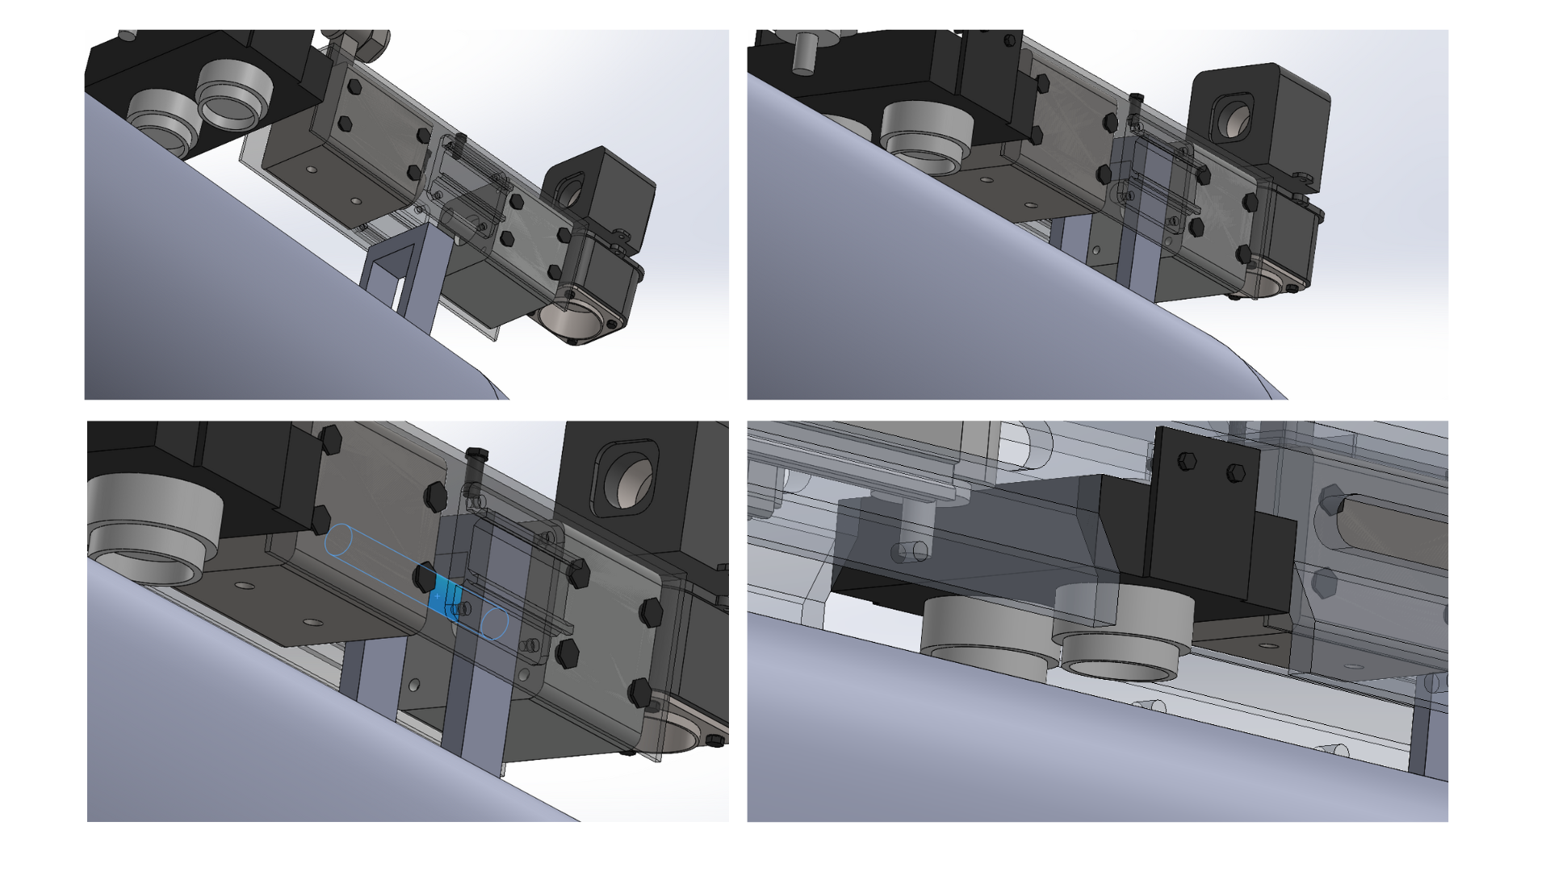
Project Objective
1.
2.
3.
4.

Slide 7
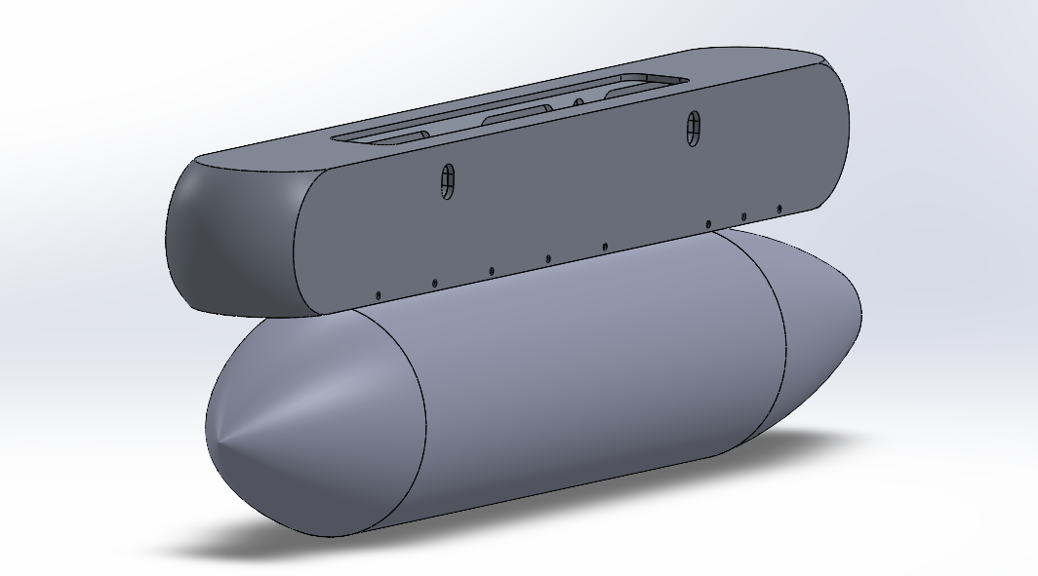
Project Objective
Hardpoint fitted with payload

Slide 8
Scope of Work
Design and integrate essential components for the underwing payload hardpoint system.
Implement lock and release mechanisms for secure attachment and controlled deployment of the payload.
Create an electrical interface for connecting the hardpoint to the aircraft's power and control systems.
Include aerodynamic fairings to minimize drag.
Develop mounting brackets to secure the hardpoint to the aircraft.
Design load-bearing mechanisms to effectively distribute forces.
Incorporate reliant systems to ensure safety and reliability.
Exclude the development of control software, avionics data link bus, diagnostic systems, and ground support equipment from the project scope.

Slide 9
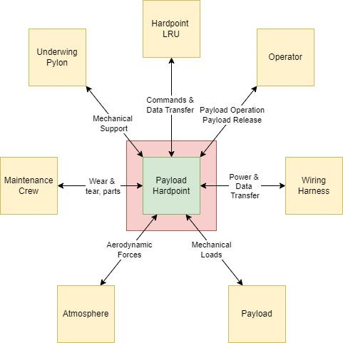
Technical Approach
Our technical approach ensures a robust, flexible, and responsive underwing payload hardpoint system, enhancing versatility, structural integrity, and aerodynamic performance while incorporating advanced fail-safe mechanisms for reliability.
Pylon Interface: Utilizes an aerodynamically shaped pylon to interface with the wing, ensuring smooth airflow and maintaining structural integrity.
Main Structural Member: Employs a central longitudinal structural member to provide stability and strength, serving as the backbone of the hardpoint system.
Latching Actuators: Positions multiple latching linear actuators longitudinally along the wing chord for fast response and secure payload locking.
Fig: Context Diagram

Slide 10
Technical Approach
Proximity Sensors: Integrates proximity sensors to detect latch positions and the presence/absence of the payload, enhancing system feedback and control.
Rails: Incorporates rails on the main structural member to allow for adjustability, accommodating various payload sizes and shapes.
Wiring Interface: Features a rigid but adjustable wiring interface with a quick disconnect capability to ensure reliable connections for arming and control.
Internal Wiring: Connects internal wiring with the cockpit to manage the hardpoint and actuators, enabling precise control and operation.
Aerodynamic Fairing: Attaches a lightweight composite fairing to reduce drag and improve aerodynamic efficiency.
Fail-Safe Mechanism: Locking of actuators in latched position in case of power failure.

Slide 11
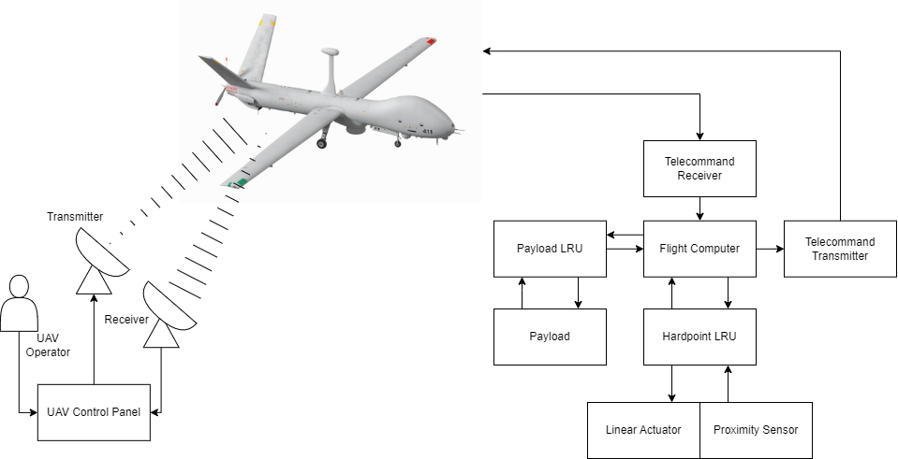
UAV Operator Interface Architecture

Slide 12
Assumptions & Constraints
Indigenous Technology Requirement: The project must incorporate a high percentage of indigenous technology, which may limit the choice of materials, components, and technology sources.
Design and Production Standards: The system must meet specific design and production standards, such as SAE ARP4754A, which could impose constraints on the design process and production techniques.
Integration into Existing Platforms: The design must ensure compatibility and seamless integration with various existing airborne platforms, which may limit design flexibility and require adherence to certain interoperability standards.
Cost Constraints: The project must be designed to be cost-effective, impacting decisions on materials, production methods, and overall system design to keep costs low for fitting, maintenance, and operation.

Slide 13
Requirements/Compliance Matrix

Slide 14
Compliance Matrix (Tier-1)
Requirement ID | Requirement | Requirement Type | Requirement Validity | Traceability/ Rationale | Product Verification Method | Product Verification Owner | Product Verification Evidence | Verification Comments | Compliance
TIER 1 REQUIREMENTS
T1-R-1 | The UAV, with this hardpoint, should be able to support the carry & operation of a wide range of payloads found on MALE UAVs without significantly affecting the performance characteristic of the UAV. | Customer | Valid | - | Analysis, Test | Requirements Engineer | - | - | Intend to comply
T1-R-2 | The hardpoint mechanism should be compact & lightweight so that it is easy to integrate with the UAV structure without impeding operational capability. |  | Valid | - | Inspection, Review | Requirements Engineer | - | - | Intend to comply
T1-R-3 | The hardpoint mechanism should be compatible with standard modern avionics systems, resulting in ease of product integration without major modifications & reliable operations. |  | Valid | - | Test, Review | Requirements Engineer | - | - | Intend to comply
T1-R-4 | The UAV should be able to utilise the hardpoint mechanism reliably throughout the expected flight envelope i.e. given range of altitudes, speed, flight conditions etc. |  | Valid | - | Analysis, Test | Requirements Engineer | - | - | Intend to comply
T1-R-5 | The mechanism block volume of the hardpoint must be with in 120x20x20 cm |  | Valid | - | Inspection, Review | Requirements Engineer | Engineering drawings and CAD model | - | Intend to comply

Slide 15
Compliance Matrix (Tier-2, 1/3)
Requirement ID | Requirement | Requirement Type | Requirement Validity | Traceability/ Rationale | Product Verification Method | Product Verification Owner | Product Verification Evidence | Verification Comments | Compliance
T2-R-1 | Operable in the flight envelope of up to 10,000m altitude, +3g -3g limit load (in pull up & pull down maneuvers in the longitudinal axis), & forward speeds of 300km/h | Operational | Valid | Expected flight envelope of typical MALE UAV | Analysis, Test | Design Engineer | Tests & Hand Calculations performed, refer analysis document | - | Intend to comply
T2-R-2 | Actuator selected shall be robust & reliable to the highest degree possible, ensuring that the payload is not released under non-ideal conditions |  | Valid | - | Test, Review | Design Engineer | component reliability analysis, actuator stress testing | Tested under operational conditions | Intend to comply
T2-R-3 | A provision to detect the jettison/launch of the payload upon actuation should exist |  | Valid | - | Test, Inspection | Design Engineer | Integration test results, Inspection report | Detection system validated with dummy payload | Intend to comply
T2-R-4 | Implement plungers that will give negative displacement of payload upon ejection/jettison of the payload, clearing it from the UAV body |  | Valid | - | Test, Inspection | Design Engineer | Clearing mechanism tested for multiple payload configurations | - | Intend to comply

Slide 16
Compliance Matrix (Tier-2, 2/3)
Requirement ID | Requirement | Requirement Type | Requirement Validity | Traceability/ Rationale | Product Verification Method | Product Verification Owner | Product Verification Evidence | Verification Comments | Compliance
T2-R-5 | Maximum Payload Weight shall be 100kg | Performance | Valid | Based on the currently used missiles AIM-9 Sidewinder - 85kg IRIS-T- 87.4kg | Analysis, Test | Design Engineer | Load test reports | Validated up to 100 kgs of payload weight | Intend to comply
T2-R-6 | The system offers minimum drag to the aircraft |  | Valid | Maximization of range/endurance | Analysis, Test | Design Engineer | Wind tunnel test results, CFD analysis | Drag coefficient within acceptable limits | Intend to comply
T2-R-7 | Payload release shall happen within 50ms of receiving signal |  | Valid | Circular Error Probable (CEP) of typical weapons payload is expected to be < 3 m. Assume max speed of 220 kph, time taken to travel 3 m is ~0.05 seconds. | Test | Design Engineer | - | - | Intend to comply
T2-R-8 | The hardpoint mechanism shall endure emergency loads such as gusts, landings, maneuvers (+2.5g to -1.0g) |  | Valid | FAR Part 25 | Analysis, Test | Design Engineer | - | - | Intend to comply

Slide 17
Compliance Matrix (Tier-2, 3/3)
Requirement ID | Requirement | Requirement Type | Requirements Validity | Traceability/Rationale | Product Verification Method | Product Verification Owner | Product Verification Evidence | Verification Comments | Compliance
T2-R-9 | The weight of the hardpoint shall not exceed 35 kg | Physical & Installation | Valid | Similarity to BRU-32 Ejector Rack | Inspection, Review | Design Engineer | Weight measurement report |  | Intend to comply
T2-R-10 | The mechanism shall accommodate infrastructure to provide at least 1 kW Electrical Power to payload |  | Valid | From the literature, the maximum power consumption was of an EO/IR payload. | Test, Inspection | Design Engineer | Power consumption test reports | Power requirements met under full load conditions | Intend to comply
T2-R-11 | The electronics of the mechanism shall interface with MIL-STD-1553B Avionics Bus | Interface | Valid | MIL-STD-1553B is a widely used avionics data bus in military aviation applications. | Test, Review | Design Engineer | - | - | Intend to comply
T2-R-12 | The hardpoint mechanism shall have easy integration with structural elements under the wing of the UAV |  | Valid | - | Inspection, Review | Design Engineer | Interface compatibility test results | - | Intend to comply
T2-R-13 | The actuators of the hardpoints should have a failure rate of < 1*10^-7 occurences per flight | Maintenance | Valid | MIL-STD-8591 | Test, Service Experience | Design Engineer, Manufacturer | Failure mode analysis, service logs | Service data reviewed for reliability validation | Intend to comply
T2-R-14 | The structural elements of the hardpoint mechanism should not require maintenance/overhaul before 750 flight hours or 35 sorties, whichever comes first. |  | Valid | "B"-Check intervals for MRO, NITI Aayog | Test, Service Experience | Design Engineer, Manufacturer | - | - | Intend to comply
T2-R-15 | Withstand vibrations upto 3g in all axises with wing’s natural frequency of 20Hz | Performance | Valid | The natural frequency of the wing is 20hz | Test,Analysis | Design, analysis engineer | modal & vibration testing | The vibrational load requirement were met | Intend to comply

Slide 18
Compliance Matrix (Tier-3, 1/3)
Requirement ID | Requirement | Requirement Type | Requirements Validity | Traceability/Rationale | Product Verification Method | Product Verification Owner | Product Verification Evidence | Verification Comments | Compliance
T3-R-1 | Operates in temperatures -45°C to 55°C and resists humidity levels upto 95% | Operational | Valid | T2-R-1 | Analysis, Test | Design Engineer | Environmental testing results, humidity and temperature cycling data | Tested under extreme temperature and humidity conditions | Intend to comply
T3-R-2 | Actuators are to be fixed in latched position in the event of power loss/failure, to prevent dropping the payload. |  | Valid | T2-R-2 | Test, Review | Design Engineer | Fail-safe mechanism review, sensor failure simulation test | Reviewed and tested to ensure payload safety | Intend to comply
T3-R-3 | Proximity sensors that have a minimum range of 10 mm shall be implemented to check payload release status |  | Valid | T2-R-3 | Test, Inspection | Design Engineer | Proximity sensor test results, inspection reports | Verified against design specifications | Intend to comply
T3-R-4 | Negative displacement plungers shall apply a force such that the ejected/jettisoned payload does not come within chord length distance of the UAV. |  | Valid | T2-R-4 | Test, Inspection | Design Engineer | Plunger force test results, ejection distance validation | Tested to ensure payload clears UAV | Intend to comply
T3-R-5 | Maximum rate of data transfer to and from electronics of mechanism shall be < 1 Mbps | Performance | Valid | T2-R-11, MIL-STD 1553B | Analysis, Test | Design Engineer | Data transfer rate test reports | Validated to meet data rate requirements | Intend to comply
T3-R-6 | Actuation mechanism shall have switching frequency > 20 Hz |  | Valid | T2-R-7 | Analysis, Test | Design Engineer, Manufacturer | actuator performance data | Tested under operational load | Intend to comply
T3-R-7 | Rail guides support lateral loads upto 1.5 times the payload weight |  | Valid | T2-R-1, T2-R-5, T2-R-8 | Analysis, Test | Design Engineer | Load test reports, rail guide analysis | Validated under maximum load conditions | Intend to comply
T3-R-8 | The aerodynamic fairings must generate drag that is less than 10% of the total drag produced by the aircraft |  | Valid | T2-R-6 | Analysis, Test | Design Engineer, Analysis Engineer | Wind tunnel test results, CFD analysis | Drag coefficient validated against aircraft data | Intend to comply

Slide 19
Compliance Matrix (Tier-3, 2/3)
Requirement ID | Requirement | Requirement Type | Requirements Validity | Traceability/Rationale | Product Verification Method | Product Verification Owner | Product Verification Evidence | Verification Comments | Compliance
T3-R-9 | Payload hook interfaces are to sustain +ve load of payload*3g (~3000N) & -ve load of payload*3g (~3000N) | Performance | Valid | T2-R-1, T2-R-5, T2-R-8 | Analysis, Test | Design Engineer, Analysis Engineer | Structural load test results, finite element analysis | - | Intend to comply
T3-R-10 | Rail mount that interfaces the latches to the main body of the hard point are to sustain a UDL of 15 kN/m |  | Valid | T2-R-1, T2-R-5, T2-R-8, + load of structural elements | Analysis, Test | Design Engineer, Analysis Engineer | Structural load test results, finite element analysis | Tested for ultimate load conditions | Intend to comply
T3-R-11 | Bolts that fasten the latch actuator to the guide rail shall sustain an eccentric load of 1500 N at a distance of 28.45 mm from CoG |  | Valid | T2-R-1, T2-R-5, T2-R-8, + load of structural elements | Analysis, Test | Design Engineer, Analysis Engineer | Eccentric load test reports, bolt stress analysis | Validated to meet load requirements | Intend to comply
T3-R-12 | Bolts at the top of the latch mechanism casing shall sustain an axial load of 1500 N |  | Valid | T2-R-1, T2-R-5, T2-R-8, + load of structural elements | Analysis, Test | Design Engineer, Analysis Engineer | Axial load test results, structural integrity reports | Bolts tested to ensure structural reliability | Intend to comply
T3-R-13 | The actuators are to be daisy-chained with the power supply for the payload. Thus maximum actuation power is derived from the max power infrastructure (i.e. 1kW) | Physical & Installation | Valid | T2-R-2, T2-R-10 | Test, Review | Design Engineer | Power supply test reports, actuator performance analysis | Tested under full power load conditions | Intend to comply
T3-R-14 | Wiring harnesses between UAV EPDS, payload, & mechanism should be rated for >= 32 V & >= 40 A |  | Valid | T2-R-10 | Test, Inspection | Design Engineer, Manufacturer | Wiring harness test results, inspection reports | Tested against standard ratings | Intend to comply
T3-R-15 | Fastener spacing & installation shall follow aerospace recommended standards |  | Valid | T2-R-12 | Inspection, Review | Design Engineer | Inspection report based on aerospace standards | Complied with recommended spacing and installation practices | Intend to comply
T3-R-16 | Fasteners such as bolts, nuts, washers, shall conform to standard available sizes and helical threading with Allen-key slots. |  | Valid | T2-R-12 | Inspection, Review | Design Engineer | Inspection report on fastener conformity | Checked against standard size and threading requirements | Intend to comply

Slide 20
Compliance Matrix (Tier-3, 3/3)
Requirement ID | Requirement | Requirement Type | Requirements Validity | Traceability/Rationale | Product Verification Method | Product Verification Owner | Product Verification Evidence | Verification Comments | Compliance
T3-R-17 | Electronic interface of mechanism shall be twinax connector & cable | Interface | Valid | T2-R-11, MIL-STD 1553B | Inspection, Review | Design Engineer | Connector and cable inspection report, MIL-STD compliance documentation | Inspected to ensure proper interface connections | Intend to comply
T3-R-18 | Linear actuator should be able to go through 1*10^7 cycles without failure | Maintenance | Valid | T2-R-13 | Testing, Service Experience | Design Engineer, Manufacturer | Actuator cycle testing data, service life report | Tested to validate actuator durability under cycling conditions | Intend to comply
T3-R-19 | Actuator armatures should not experience failure level fatigue before 750 flight hours or 35 sorties, whichever comes first. |  | Valid | T2-R-14 | Testing, Service Experience | Design Engineer, Manufacturer | Fatigue testing report, service life data | Evaluated to ensure fatigue resistance meets required hours/sorties | Intend to comply
T3-R-20 | Structural members of the hardpoint mechanism should not experience failure level fatigue before 750 flight hours or 35 sorties, whichever comes first. |  | Valid | T2-R-14 | Testing, Service Experience | Design Engineer, Manufacturer | Fatigue testing report, structural integrity data | Tested to ensure structural members meet fatigue life requirements | Intend to comply

Slide 21
Example of Traceability & Rationale from Tier-1 to Tier-2 to Tier-3 Requirements
Requirement ID | Requirement | Requirement Type | Requirement Validity | Traceability/ Rationale | Product Verification Method | Product Verification Owner | Product Verification Evidence | Verification Comments | Compliance
T1-R-1 | The UAV, with this hardpoint, should be able to support the carry & operation of a wide range of payloads found on MALE UAVs without significantly affecting the performance characteristic of the UAV. | Customer | Valid | - | Analysis, Test | Requirements Engineer | - | - | Intend to comply
T2-R-1 | Operable in the flight envelope of up to 10,000m altitude, +3g -3g limit load (in pull up & pull down maneuvers in the longitudinal axis), & forward speeds of 300 km/h | Operational | Valid | Expected flight envelope of typical MALE UAV | Analysis, Test | Design Engineer | Tests & Hand Calculations performed, refer analysis document | - | Intend to comply
T2-R-5 | Maximum Payload Weight shall be 100kg | Performance | Valid | Based on the currently used missiles AIM-9 Sidewinder - 85kg IRIS-T- 87.4kg | Analysis, Test | Design Engineer | Load test reports | Validated up to 100 kgs of payload weight | Intend to comply
T2-R-8 | The hardpoint mechanism shall endure emergency loads such as gusts, landings, maneuvers (+2.5g to -1.0g) |  | Valid | FAR Part 25 | Analysis, Test | Design Engineer | - | - | Intend to comply
T3-R-10 | Rail mount that interfaces the latches to the main body of the hardpoint are to sustain a UDL of 15 kN/m | Performance | Valid | T2-R-1, T2-R-5, T2-R-8, + load of structural elements | Analysis, Test | Design Engineer, Analysis Engineer | Structural load test results, finite element analysis | Tested for ultimate load conditions | Intend to comply

Slide 22
Failure Modes and Effects Analysis (FMEA), (1/2)
Item/Function | Requirement | Potential Failure mode | Potential effects of failure | Severity of effect (SEV) | Potential causes/ mechanism of failures | Likely to occur (OCC) | Current process controls | Detect (DET) | RPN
Bolts | Bolts at the top of the latch mechanism casing shall sustain an axial load of 1500 N | Failure of the bolt in tension | Hardpoint detaches from pylon | 10 | Fatigue, Impact of impulse loads/shocks, poor maintenance. High G force maneuvers out of flight envelope | 1 | - Material strength testing - Torque checks - Regular inspections | 7 | 70
 |  | Shearing of threads |  | 10 |  | 2 | - Thread design standards - Thread quality checks - Proper lubrication | 7 | 140
 | Bolts that fasten the latch actuator to the guide rail shall sustain an eccentric load of 1500 N at a distance of 28.45 mm from CoG | Shearing of bolts |  | 10 | Fatigue, Impact of impulse loads/shocks, poor maintenance. High G force maneuvers out of flight envelope | 2 | - Shear strength testing - Correct bolt sizing - FEA validation | 7 | 140
Rail guide | Rail mount that interfaces the latches to the main body of the hard point are to sustain a UDL of 100 KN/m | Bending of Rail guide | Damage to payload; detachment of payload from hardpoint. | 8 |  | 3 | - Material testing - Structural analysis - Non-destructive testing (NDT) | 8 | 192
 | Rail guides support lateral loads upto 1.5 times the payload weight | Twisting of Rail guide |  | 8 |  | 3 | - Lateral load testing - Design reinforcement - Visual inspection | 8 | 192

Slide 23
Failure Modes and Effects Analysis (FMEA), (2/2)
Item/Function | Requirement | Potential Failure mode | Potential effects of failure | Severity of effect (SEV) | Potential causes/ mechanism of failures | Likely to occur (OCC) | Current process controls | Detect (DET) | RPN
Linear Actuator | Linear actuator should be able to go through 1*10^7 cycles without failure | Failure of the actuation mechanism to open | Failure of payload to deploy at the required time. | 9 | Overuse of actuators, poor maintenance, electrical issues, lightning strike. | 1 | - Cycle endurance testing - Regular lubrication - Condition monitoring | 2 | 18
 | Payload release shall happen within 50ms of receiving signal | Slow opening of actuation mechanism |  | 6 | Overuse of actuators, poor maintenance, electrical issues, lightning strike. | 2 | - Response time testing - Signal integrity checks - Redundant release mechanisms | 2 | 24
Proximity Sensor | Proximity sensors that have a minimum range of X m shall be implemented to check payload release status | Proximity Sensors fail to sense jettison of payload | No feedback on payload launch. | 4 | Poor maintenance, electrical issues, lightning strike. | 1 | - Sensor calibration - Redundant sensors - Signal integrity testing | 3 | 12
Twinax Electronic connectors | Electronic interface of mechanism shall be twinax connector & cable | Connection failure between LRU & avionics bus | Inability to communicate with payload/ actuators | 7 |  | 4 | - Connector inspections - Environmental testing - Redundant connections | 5 | 140
EPDS Wiring Harness | Wiring harnesses between UAV EPDS, payload, & mechanism should be rated for >= 32 V & >= 40 A | Failure to deliver power to hardpoint & payload | Inability to operate payload/ actuators on hardpoint. | 7 |  | 4 | - Voltage & current testing - Insulation checks - Proper routing and shielding | 5 | 140

Slide 24
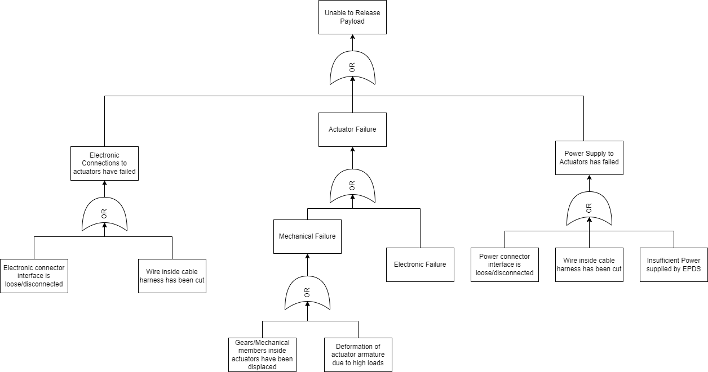
Fault Tree Analysis

Slide 25
Schedule/Milestones

Slide 26
Milestone Description
Milestone | Description
Conceptual Design | Evaluation of the initial system concepts and high-level requirements
System Requirements Review | Review of the detailed system requirements to confirm they are complete, feasible, and traceable to the high-level requirements and safety objectives.
Preliminary Design Review (PDR) | Assessment of the preliminary design to ensure it meets the system requirements and provides a sufficient basis for proceeding with detailed design and development.
Critical Design Review (CDR) | A comprehensive evaluation of the complete system design to ensure it meets all specified requirements, is mature enough for production, and confirms that all critical issues have been resolved and the design is ready for implementation and integration.

Slide 27
Detail Design Review

Slide 28
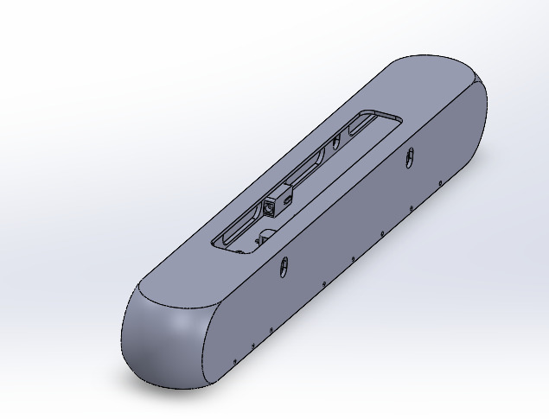
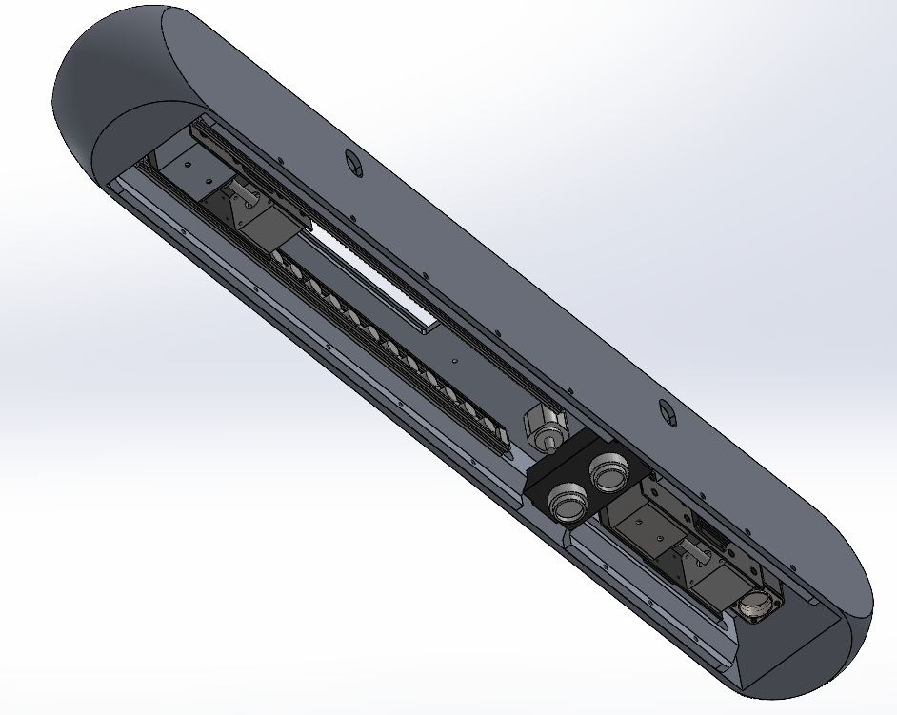
Design Overview
Fig. Isometric view of the hardpoint
Fig. Bottom view of the hardpoint

Slide 29
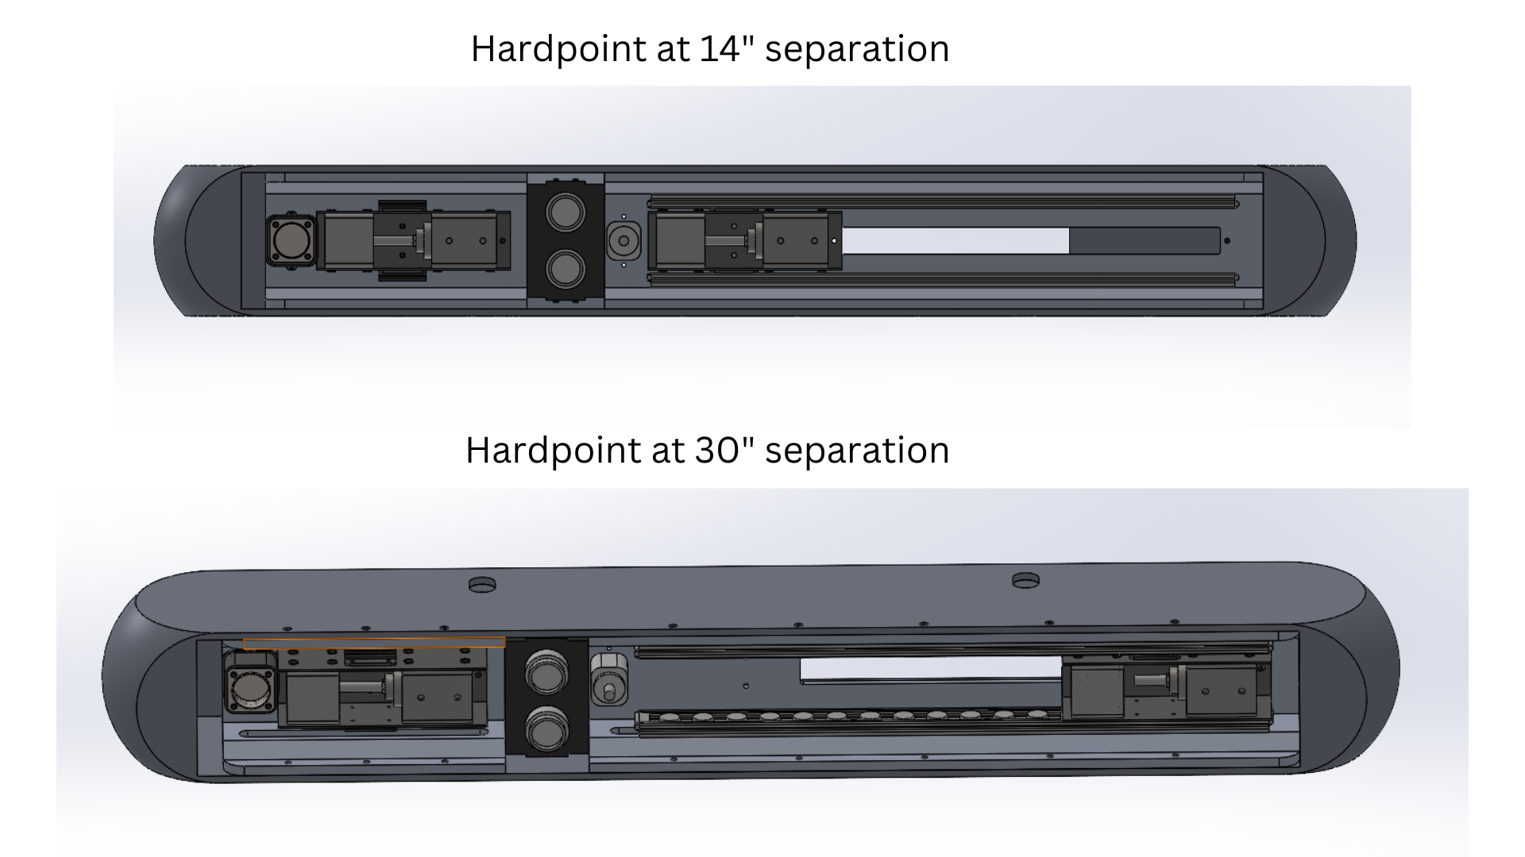
Design Overview

Slide 30
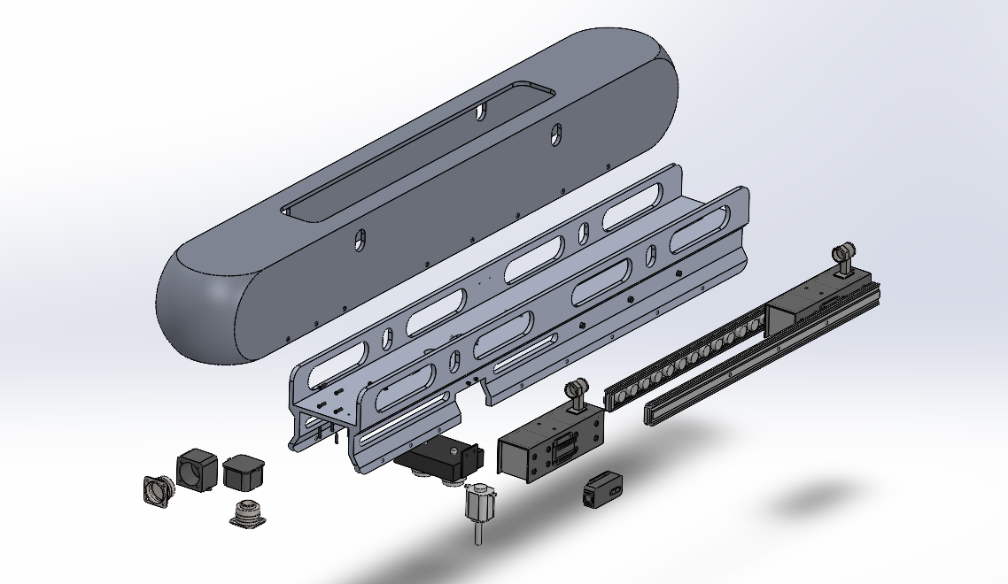
Design Overview
Exploded View of Assembly

Slide 31
Design Overview - Bill of Materials
COTS Components
Sl. No | Component | Manufacturer | No. Required
1 | GSX20 Integrated Motor Linear Actuator | Exlar Corporation | 2
2 | PRT30-15DC Proximity Sensor | Indus Automation | 2
3 | Plunger (Linear Solenoid LHP035) | Kendrion | 1
In-House Components
Sl. No | Component | Material | No. Required
4 | Aerodynamic Fairing | Fibreglass | 1
5 | Main Structural Member | Aluminium 7074 T6 | 1
 | Rail Guides | Aluminium 2024 T3 | 2
7 | Latch Couple | SS-316, Fibreglass | 2
8 | Latch Assembly Mount | Fibreglass | 2
9 | M4x0.5 Bolt (13 mm) | Carbon Steel, Black Oxide Coating | 18
10 | M5x0.5 Bolt (12 mm) | Carbon Steel, Black Oxide Coating | 5
11 | M6x0.75 Bolt (8 mm) | Carbon Steel, Black Oxide Coating | 28
12 | M6x0.75 Bolt (20 mm) | Carbon Steel, Black Oxide Coating | 23
13 | Washer, 1mm Thickness | Carbon Steel, Black Oxide Coating | 74

Slide 32
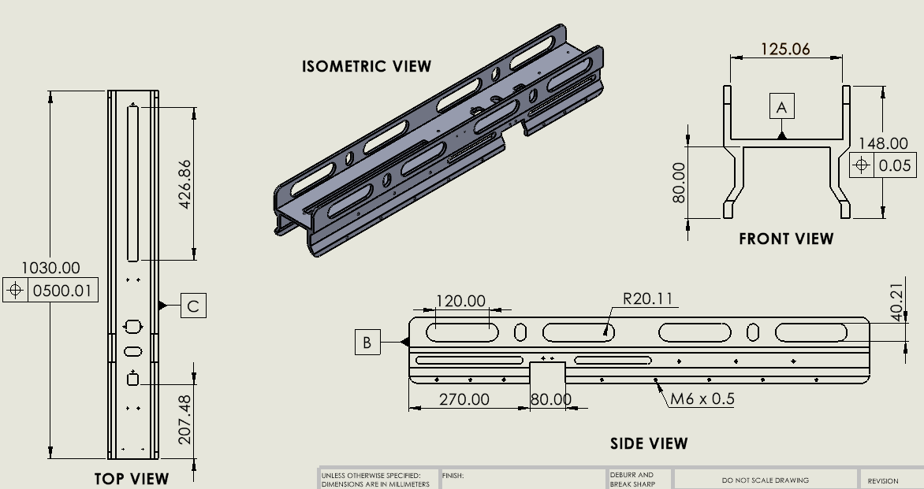
Design Overview - Main Structural Member

Slide 33
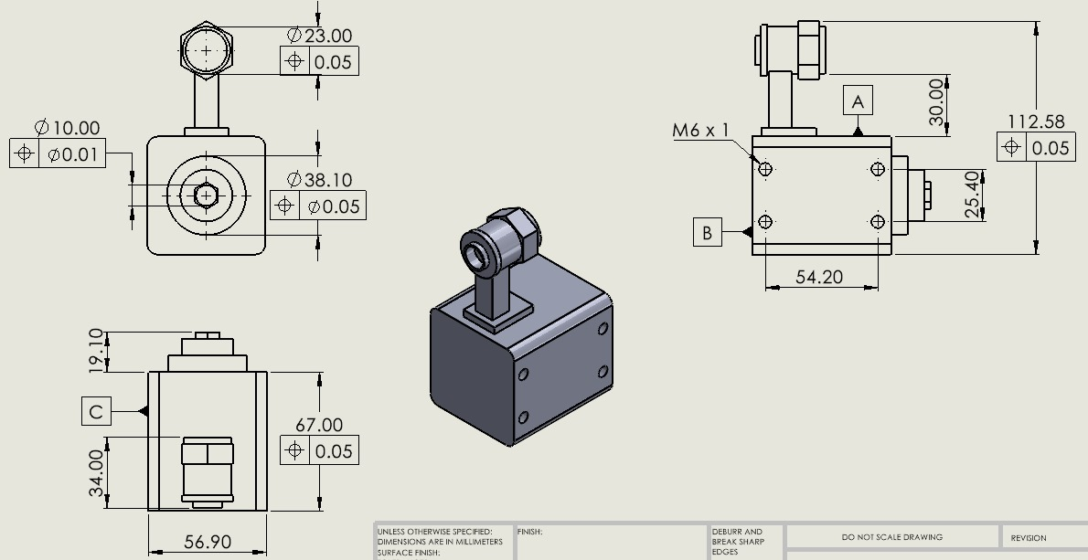
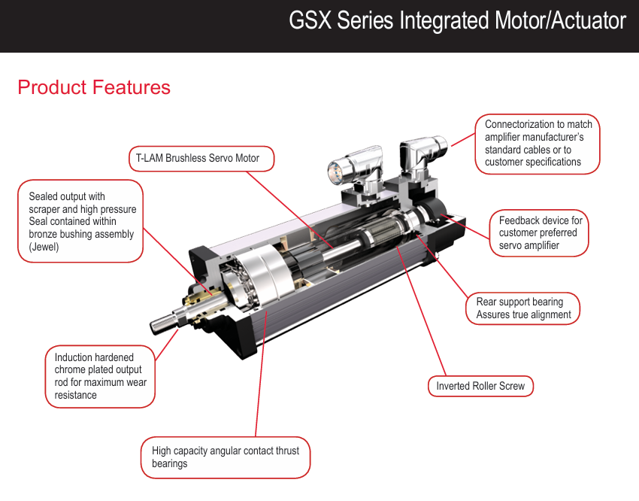
Design Overview - Latching Actuator (COTS Component)

Slide 34
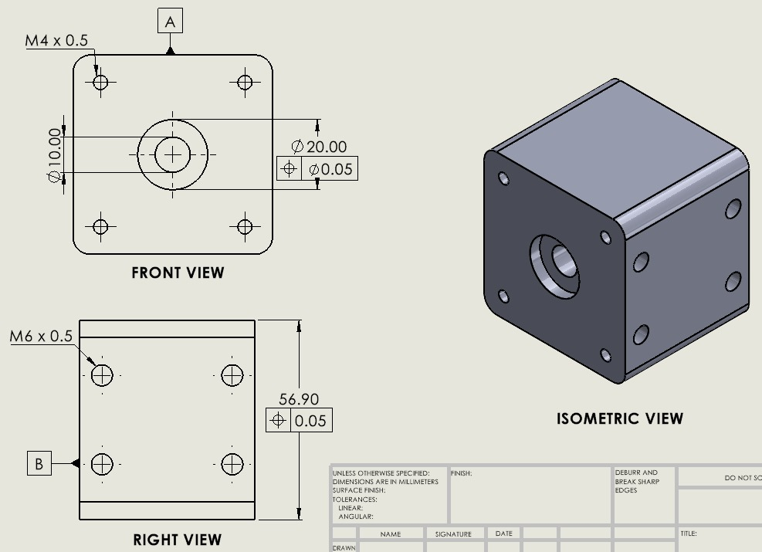
Design Overview - Latch Couple

Slide 35
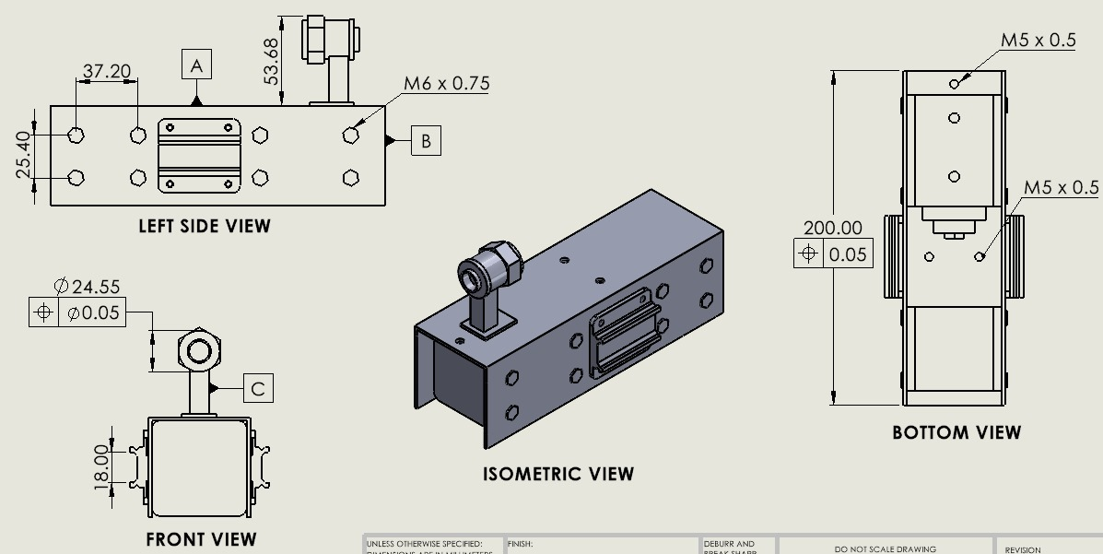
Design Overview - Latching Actuator Assembly

Slide 36
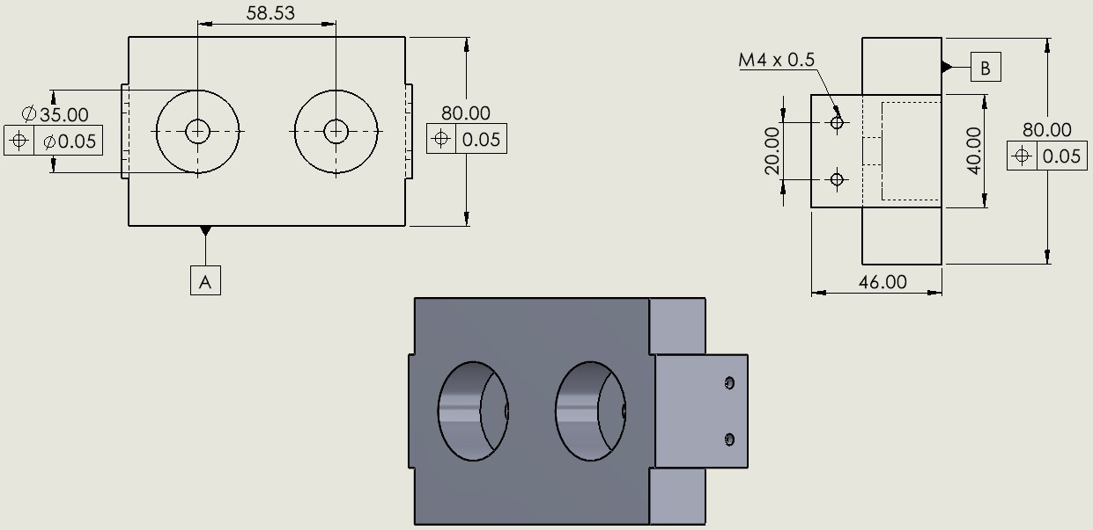
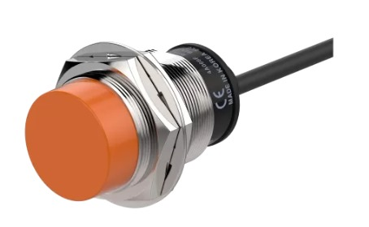
Design Overview - Proximity Sensor Mount
FRONT VIEW
SIDE VIEW
Indus Automation PRT30-15DC
ISOMETRIC VIEW

Slide 37
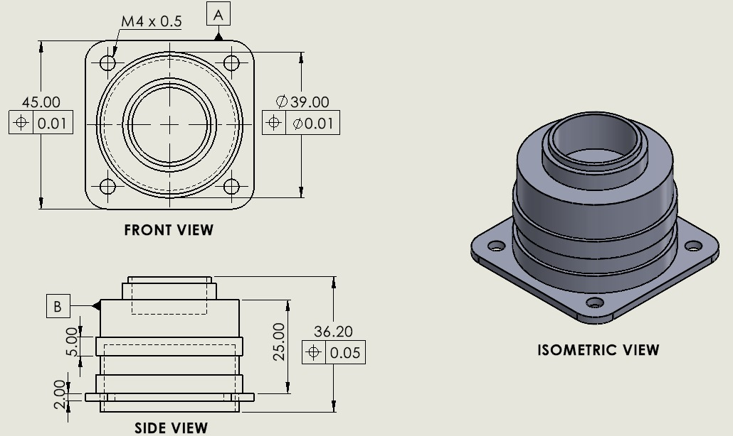
Design Overview - 8D8 Connector

Slide 38
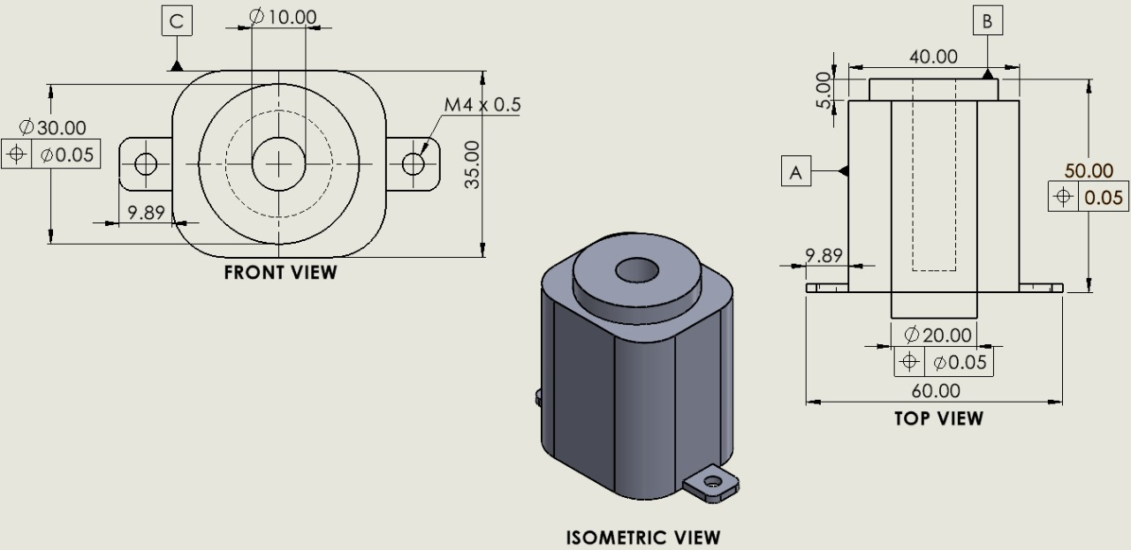
Design Overview - Plunger

Slide 39
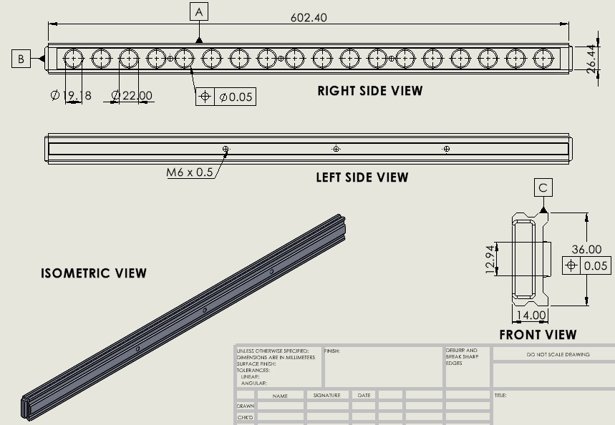
Design Overview - Rail Guide

Slide 40
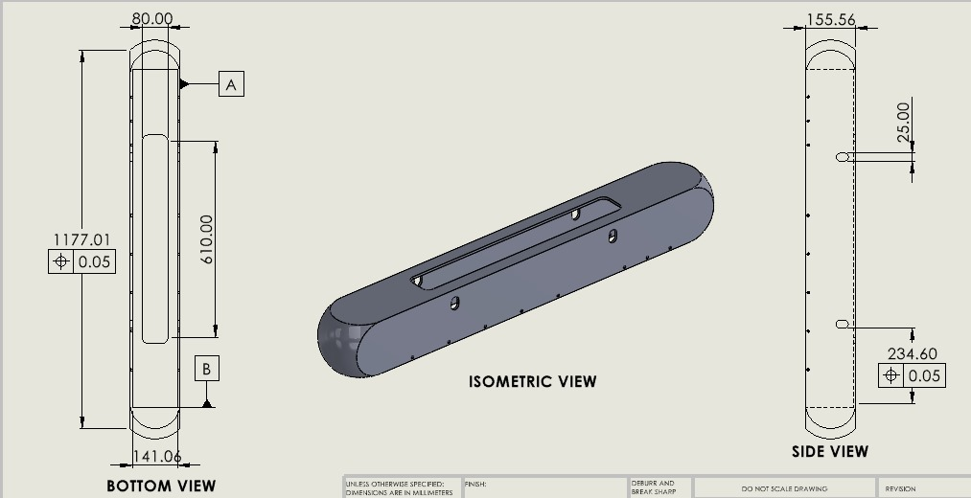
Design Overview

Slide 41
Production (1/3)
Aerodynamic Fairing (Composite Material)
Design & Tooling: CAD modeling & precision CNC for mold creation
Composite Layup: Layup of composite materials, prepreg methods for resin infusion
Curing: Autoclave curing, followed by inspection for defects
Trimming & Finishing: Trimming to shape using precision tools, surface finishing by sanding & coating
Main Structural Beam (H-Beam)
Material Selection: Aluminium 7075 T6, for strength-to-weight ratio & corrosion resistance
Extrusion: Produce long continuous & consistent sections; cooling & straightening to remove residual stress
Heat Treatment: T6 temper to enhance mechanical properties
Machining: Machined to achieve precise dimensions for attachment points & interfaces
Finishing: Surface treatments (anodizing) for corrosion resistance
Latch Assembly
Component fabrication of latch and case
Assembly of latch and case within protective casing
Testing and verification for smooth operation & secure locking

Slide 42
Production (2/3)
4. Latching Actuator (COTS)
Components: Precision-machined housing and internal parts.
Assembly: Integration of motor/piston, gears.
Testing: Force output, response time, reliability.
5. Proximity Sensor Module
Polyurethane casing fabrication for housing & protection
Sensor mounting and wiring
System integration and testing for accurate detection and reliability
6. Proximity Sensors (COTS)
Fabrication: Semiconductor processes, encapsulated in protective housing.
Assembly: Mounted on circuit board/casing.
Testing: Calibration, environmental resilience.

Slide 43
Production (3/3)
7. 8D8 Connector
Components: Stamped/plated pins, durable housing.
Assembly: Pin insertion, sealing.
Testing: Electrical continuity, resistance checks.
8. Latch Couple
Material: High-strength metals (Stainless steel).
Process: Precision machining, heat treatment.
Assembly: Fit with latch, secure engagement testing.
9. Solenoid Plunger
Components: Ferromagnetic core, copper coil, non-magnetic housing.
Assembly: Coil insertion, electrical connections, sealing.
Testing: Actuation force, response time.

Slide 44
Assembly (1/2)
Prepare Components
Inspect components, Clean surfaces.
Mount Rail Guides
Position rail guides, Secure rail guides.
Mount Latching Actuators
Prepare actuators, Position actuators, Connect actuators.
Assemble Latch Assembly
Prepare latch assembly, Mount latch assembly, Connect latch assembly.
Mount Proximity Sensors
Select sensors, Position sensors, Connect sensors.

Slide 45
Assembly (2/2)
6. Connect 8D8 Connector
Prepare connector, Position connector, Connect connector.
7. Mount Latch Couple
Prepare latch couple, Position latch couple, Connect latch couple.
8. Mount Latching Actuator and Brackets
Prepare solenoid latch and brackets, Mount brackets,
Mount solenoid latch, Connect solenoid latch.
9. Perform Functional Test
Power up system, Test latching actuators, Test proximity sensors,
Test latch couple, Test solenoid latch, Check electrical systems.
10. Final Inspection

Slide 46
Analysis

Slide 47
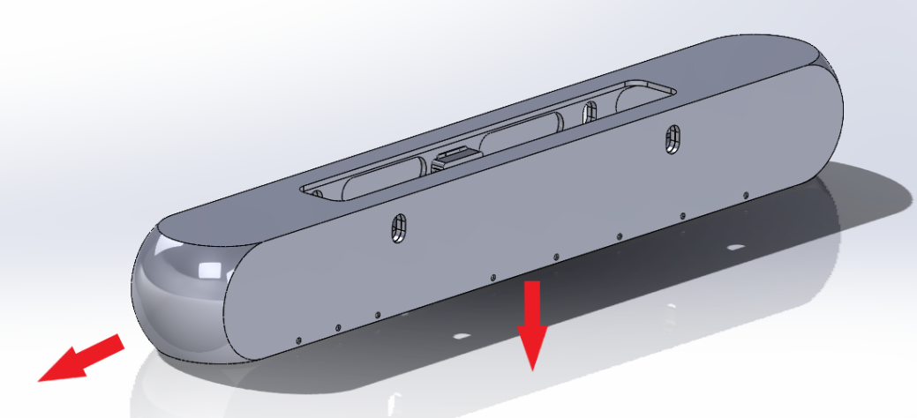
Stress Analysis
Assumptions
The UAV motions is assumed to be in positive X direction.
The gravity is acting in the negative Z direction.
The G forces are acting in the negative Z direction with a magnitude of maximum ±3 G’s.
Negative Z axis
Positive X axis

Slide 48
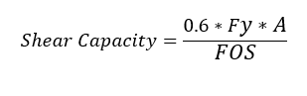
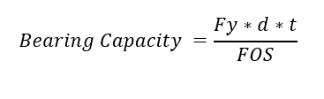
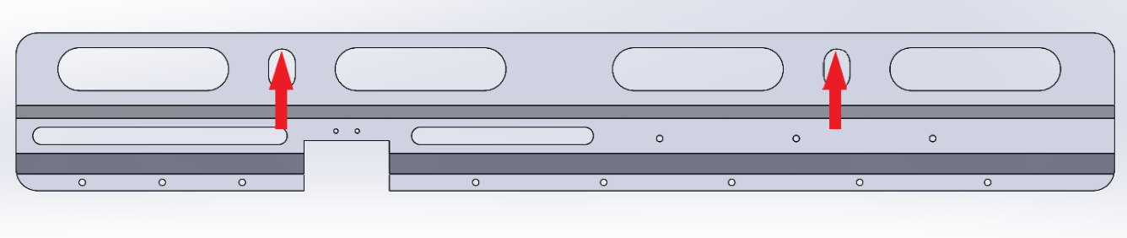
Main Structure Member
Assumptions
The load bearing members are the circular holes shown in the diagram.
The main structure member experiences a shear load on the circular hole.
The force is assumed to be in the - Z direction.
Formulae Used
Fig: FBD for main structure member

Slide 49
Main Structure Member
Calculations
Material Used for bolts : AR400 Carbon Steel
Ultimate Tensile Strength : 1241 MPa
Shear capacity : 174.981 kN
Ultimate Load on the member: 4.410 kN
Ultimate Load on single bolt : 1.102 kN
Bearing Capacity: 231.653 kN
Bolt Diameter: M28

Slide 50
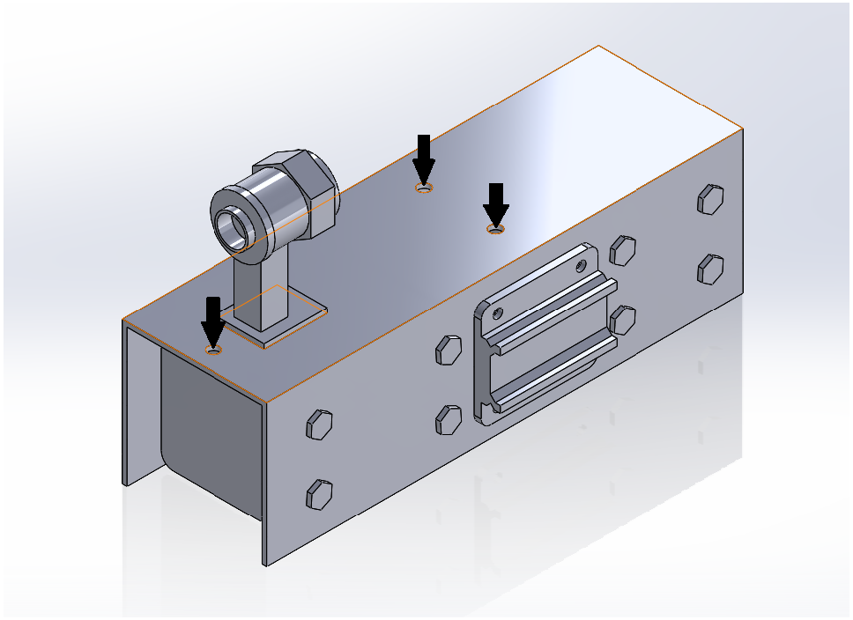
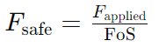
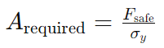
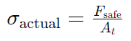
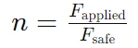
Axial Loading
Assumptions
The load bearing members are the bolts/holes shown in the figure.
The Latch assembly experiences axial loading acting on the bolts.
The force is assumed to be in the - Z direction.
Material used for bolt - AR400 Carbon Steel
Formulae used
= 588 N
= 2.87 mm²
= 41.408 MPa (Tensile stress area = 14.2mm² assumed due to M5 Thread)
= 2.5

Slide 51
External Thread Shear
Thread Shear area for external thread, A_{ts.ext} = 23.55 (Considering 12 mm thread length)
Shear stress, τ_{ts.ext} = 73.46 N/mm²
Factor of Safety, (FoS) = 184/73.56 = 2.501 (Shear yield strength of Material = 184)

Slide 52
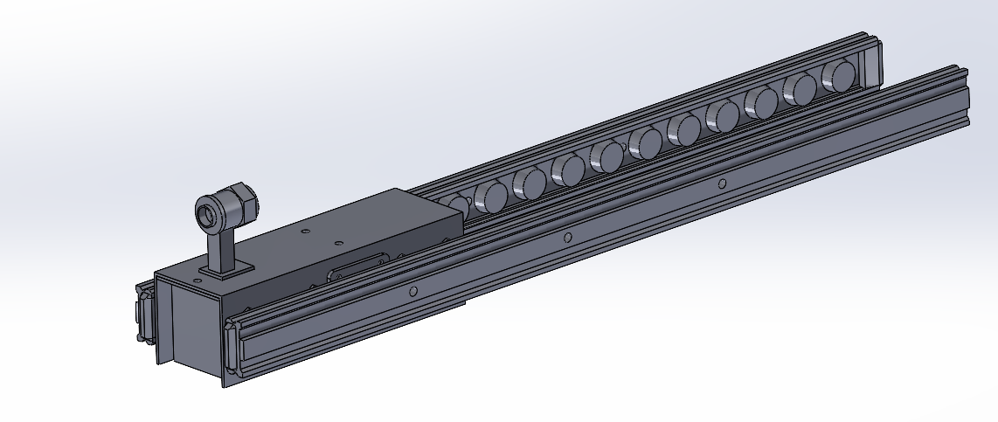
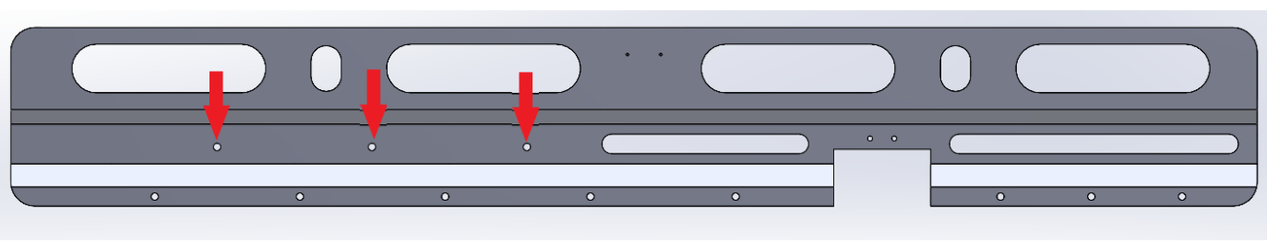
Rail Assembly
Assumption
The ultimate load is distributed between all the 6 bolts in the main structure member.
The load is transferred from the rail assembly to the main structure.
Fig: Rail guide assembly

Slide 53
Rail Assembly
Calculations
Material Used for bolts : AR400 Carbon Steel
Ultimate Tensile Strength : 1241 MPa
Shear capacity : 9.987 kN
Ultimate Load on the member: 4.410 kN
Ultimate Load on single bolt : 0.735 kN
Bearing Capacity: 4.9640 kN
Bolt Diameter: M6

Slide 54
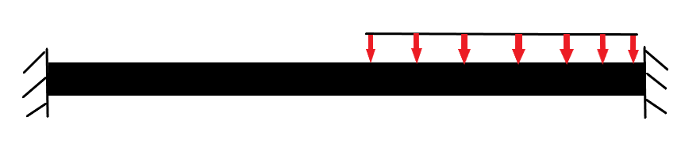
Latch arm
For the Latch arm, an Ansys APDL analysis was performed.
A Uniform distributed load (UDL) was applied for 15 mm of length with a magnitude of 98 N/mm. The total length of the arm is 41 mm.
15 mm
41 mm
Fig: FBD for Latch Arm

Slide 55
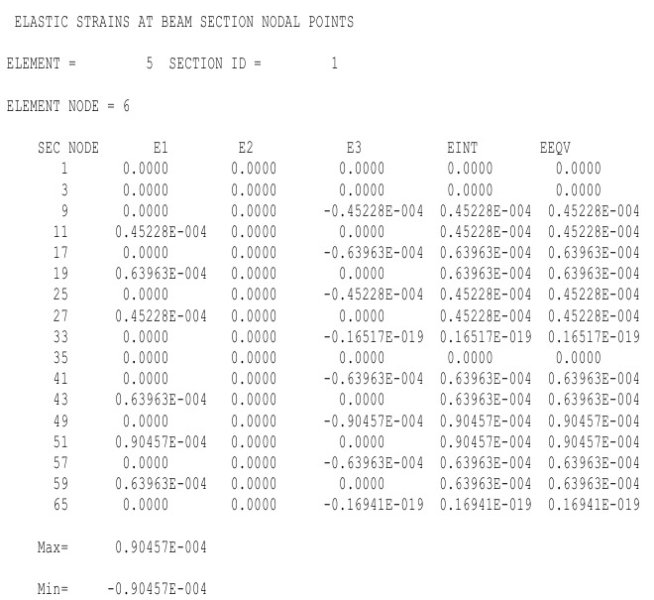
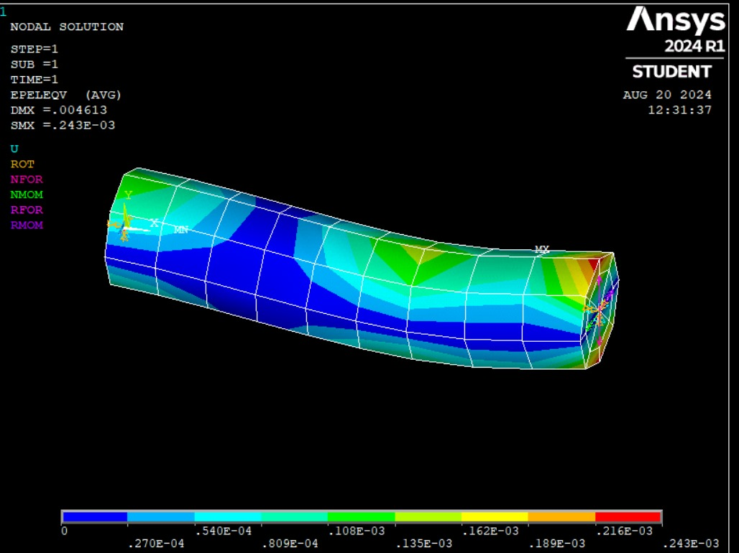
Latch Arm
Fig. Contour plot of Nodal solution
Fig. List of results for Elastic strain

Slide 56
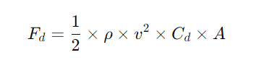
Drag Calculation
Drag force for the aircraft:
Coefficient of Drag, C_{d} = 0.015 - 0.029
UAV Frontal Area = 1.485 m²
Velocity, V = 31.11 m/sec²
Density = 0.59 kg/m³
Drag Force, F_{d} = 12.25 Newtons
Drag force of the hardpoint:
Coefficient of Drag, C_{d} = 0.17
UAV Frontal Area = 0.024 m²
Velocity, V = 31.11 m/sec²
Density = 0.59 kg/m³
Drag Force, F_{d} = 1.12 Newtons

Slide 57
Verification

Slide 58
Verification, Tier-1 (1/2)
Requirement ID | Requirement | Requirement type | Traceability | Associated Function | Verification method | Verification conclusion
T1-R-1 | The UAV, with this hardpoint, should be able to support the carry & operation of a wide range of payloads found on MALE UAVs without significantly affecting the performance characteristic of the UAV. | Customer | - | Payload Carrying and Stability Maintenance | Analysis, Test
T1-R-2 | The hardpoint mechanism should be compact & lightweight so that it is easy to integrate with the UAV structure without impeding operational capability. | Customer | - | Structural Integration and Weight Management | Inspection, Review
T1-R-3 | The hardpoint mechanism should be compatible with standard modern avionics systems, resulting in ease of product integration without major modifications & reliable operations. | Customer | - | Avionics Compatibility and Integration | Test, Review
T1-R-4 | The UAV should be able to utilise the hardpoint mechanism reliably throughout the expected flight envelope i.e. given range of altitudes, speed, flight conditions etc. | Customer | - | Operational Reliability and Environmental Adaptation | Analysis, Test
T1-R-5 | The mechanism block volume of the hardpoint must be with in 120x20x20cm | Customer | BRU-32 dimensions are taken as a reference because ejector rack uses a similar mechanism with pyrotechnic ejection charge | Volume occupied by the hardpoint | Inspection, Review

Slide 59
Verification, Tier-2 (1/4)
Requirement ID | Requirement | Requirement type | Traceability | Associated Function | Verification method | Results/Inference | Verification conclusion
T2-R-1 | Operable in the flight envelope of up to 10,000m altitude, +3g -3g, and forward speeds of 300 km/h | Operational | Expected flight envelope of typical MALE UAV | Flight Envelope Management | Analysis, Test | Pass
T2-R-2 | Actuator selected shall be robust & reliable to the highest degree possible, ensuring that the payload is not released under non-ideal conditions |  | - |  | Test, Review |  | Tested under operational conditions
T2-R-3 | A provision to detect the jettison/launch of the payload upon actuation should exist |  | - |  | Test, Inspection |  | Detection system validated with dummy payload
T2-R-4 | Implement plungers that will give negative displacement of payload upon ejection/jettison of the payload, clearing it from the UAV body |  | - |  | Test, Inspection

Slide 60
Verification, Tier-2 (2/4)
Requirement ID | Requirement | Requirement type | Traceability | Associated Function | Verification method | Results/Inference | Verification conclusion
T2-R-5 | Maximum Payload Weight shall be 100kg | Performance | Based on the currently used missiles AIM-9 Sidewinder - 85kg IRIS-T- 87.4kg | Payload Weight Management | Analysis, Test |  | Validated up to 100 kgs of payload weight
T2-R-6 | The system offers minimum drag to the aircraft |  | Maximization of range/endurance | Aerodynamic Efficiency | Analysis, Test | Pass | Drag coefficient within acceptable limits
T2-R-7 | Payload release shall happen within 50ms of receiving signal |  | Circular Error Probable (CEP) of typical weapons payload is expected to be < 3 m. Assume max speed of 220 kph, time taken to travel 3 m is ~0.05 seconds. | Rapid Response Release Mechanism | Test
T2-R-8 | The hardpoint mechanism shall endure emergency loads such as gusts, landings, maneuvers (+2.5g to -1.0g) |  | FAR Part 25 | Miscellaneous loads | Analysis, Test

Slide 61
Verification, Tier-2 (3/4)
Requirement ID | Requirement | Requirement type | Traceability | Associated Function | Verification method | Verification conclusion
T2-R-9 | The weight of the hardpoint shall not exceed 35 kg | Physical and Installation | Similarity to BRU-32 Ejector Rack | Weight Management and Structural Integrity | Inspection, Review
T2-R-10 | The mechanism shall accommodate infrastructure to provide at least 1 kW Electrical Power to payload |  | From the literature, the maximum power consumption was of an EO/IR payload. | Power Supply Integration | Test, Inspection | Power requirements met under full load conditions
T2-R-11 | The electronics of the mechanism shall interface with MIL-STD-1553B Avionics Bus | Interface | MIL-STD-1553B is a widely used avionics data bus in military aviation applications. | Avionics Interface Compliance | Test, Review
T2-R-12 | The hardpoint mechanism shall have easy integration with structural elements under the wing of the UAV |  | - | Structural Compatibility and Integration | Inspection, Review

Slide 62
Verification, Tier-2 (4/4)
Requirement ID | Requirement | Requirement type | Traceability | Associated Function | Verification method | Verification conclusion
T2-R-13 | The actuators of the hardpoints should have a failure rate of < 1*10^-7 occurences per flight | Maintenance | MIL-STD-8591 | Actuation Reliability | Test, Service Experience | Service data reviewed for reliability validation
T2-R-14 | The structural elements of the hardpoint mechanism should not require maintenance/overhaul before 750 flight hours or 35 sorties, whichever comes first. |  | "B"-Check intervals for MRO, NITI Aayog | Maintenance Minimization and Durability | Test, Service Experience

Slide 63
Verification, Tier-3 (1/5)
Requirement ID | Requirement | Requirement type | Traceability | Associated Function | Verification method | Verification conclusion
T3-R-1 | Operates in temperatures -45°C to 55°C and resists humidity levels upto 95% | Operational | T2-R-1, Range of temperatures experienced throughout flight envelope | Environmental Resilience and Operational Reliability | Analysis, Test | Tested under extreme temperature and humidity conditions
T3-R-2 | Actuators are to be fixed in latched position in the event of power loss/failure, to prevent dropping the payload. |  | T2-R-2 | Fail-Safe Mechanism for Payload Security | Test, Review | Reviewed and tested to ensure payload safety
T3-R-3 | Proximity sensors that have a minimum range of 10 mm shall be implemented to check payload release status |  | T2-R-3 |  | Test, Inspection | Verified against design specifications
T3-R-4 | Negative displacement plungers shall apply a force such that the ejected/jettisoned payload does not come within chord length distance of the UAV. |  | T2-R-4 |  | Test, Inspection | Tested to ensure payload clears UAV

Slide 64
Verification, Tier-3 (2/5)
Requirement ID | Requirement | Requirement type | Traceability | Associated Function | Verification method | Verification conclusion
T3-R-5 | Maximum rate of data transfer to and from electronics of mechanism shall be < 1 Mbps | Performance | T2-R-9, MIL-STD 1553B | Data Communication and Transfer Efficiency | Analysis, Test | Validated to meet data rate requirements
T3-R-6 | Actuation mechanism shall have switching frequency > 20 Hz |  | T2-R-5 | High-Frequency Actuation Performance | Analysis, Test | Tested under operational load
T3-R-7 | Rail guides support lateral loads upto 1.5 times the payload weight |  | T2-R-3 | Load Bearing and Structural Support | Analysis, Test | Validated under maximum load conditions
T3-R-8 | The aerodynamic fairings must generate drag that is less than 10% of the total drag produced by the aircraft |  | T2-R-4 | Aerodynamic Efficiency | Analysis, Test | Drag coefficient validated against aircraft data
T3-R-9 | Payload hook interfaces are to sustain +ve load of payload*3g (~3000N) & -ve load of payload*3g (~3000N) |  | T2-R-1, T2-R-3 | Payload Support and Load Management | Analysis, Test
T3-R-10 | Rail mount that interfaces the latches to the main body of the hard point are to sustain a UDL of 15 KN/m |  | T2-R-1, T2-R-3, + load of structural elements | Structural Support and Load Distribution | Analysis, Test | Tested for ultimate load conditions

Slide 65
Verification, Tier-3 (3/5)
Requirement ID | Requirement | Requirement type | Traceability | Associated Function | Verification method | Verification conclusion
T3-R-11 | Bolts that fasten the latch actuator to the guide rail shall sustain an eccentric load of 1500 N at a distance of 28.45 mm from CoG | Performance | T2-R-1, T2-R-3, + load of structural elements | Mechanical Fastening and Load Bearing | Analysis, Test | Validated to meet load requirements
T3-R-12 | Bolts at the top of the latch mechanism casing shall sustain an axial load of 1500 N |  | T2-R-1, T2-R-3, + load of structural elements | Fastening Integrity and Load Bearing | Analysis, Test | Bolts tested to ensure structural reliability
T3-R-13 | The actuators are to be daisy-chained with the power supply for the payload. Thus maximum actuation power is derived from the max power infrastructure (i.e. 1kW) | Physical installation | T2-R-2, T2-R-8 | Power Management and Actuation Coordination | Test, Review | Tested under full power load conditions
T3-R-14 | Wiring harnesses between UAV EPDS, payload, & mechanism should be rated for >= 32 V & >= 40 A |  | T2-R-8 | Electrical Power Distribution and Safety | Test, Inspection | Tested against standard ratings

Slide 66
Verification, Tier-3 (4/5)
Requirement ID | Requirement | Requirement type | Traceability | Associated Function | Verification method | Verifcation conclusion
T3-R-15 | Fastener spacing & installation shall follow aerospace recommended standards | Physical & Installation | T2-R-10 | Structural Integrity and Compliance | Inspection, Review | Complied with recommended spacing and installation practices
T3-R-16 | Fasteners such as bolts, nuts, washers, shall conform to standard available sizes and helical threading with Allen-key slots. |  | T2-R-10 | Standardization and Maintenance | Inspection, Review | Checked against standard size and threading requirements
T3-R-17 | Electronic interface of mechanism shall be twinax connector & cable | Interface | T2-R-9, MIL-STD 1553B | Electrical Interface Compatibility | Inspection, Review | Inspected to ensure proper interface connections
T3-R-18 | Linear actuator should be able to go through 1*10^7 cycles without failure | Maintenance | T2-R-11 | Actuation Durability and Reliability | Testing, Service Experience | Tested to validate actuator durability under cycling conditions
T3-R-19 | Actuator armatures should not experience failure level fatigue before 750 flight hours or 35 sorties, whichever comes first. |  | T2-R-12 | Actuator Durability and Fatigue Resistance | Testing, Service Experience | Evaluated to ensure fatigue resistance meets required hours/sorties
T3-R-20 | Structural members of the hardppint mechanism should not experience failure level fatigue before 750 flight hours or 35 sorties, whichever comes first. |  | T2-R-12 | Structural Durability and Fatigue Resistance | Testing, Service Experience | Tested to ensure structural members meet fatigue life requirements

Slide 67
Verification, Tier-3 (5/5)
Requirement ID | Requirement | Requirement type | Traceability | Associated Function | Verification method | Verifcation conclusion
T3-R-18 | Linear actuator should be able to go through 1*10^7 cycles without failure | Maintenance | T2-R-11 | Actuation Durability and Reliability | Testing, Service Experience | Tested to validate actuator durability under cycling conditions
T3-R-19 | Actuator armatures should not experience failure level fatigue before 750 flight hours or 35 sorties, whichever comes first. |  | T2-R-12 | Actuator Durability and Fatigue Resistance | Testing, Service Experience | Evaluated to ensure fatigue resistance meets required hours/sorties
T3-R-20 | Structural members of the hardppint mechanism should not experience failure level fatigue before 750 flight hours or 35 sorties, whichever comes first. |  | T2-R-12 | Structural Durability and Fatigue Resistance | Testing, Service Experience | Tested to ensure structural members meet fatigue life requirements

Slide 68
Qualification

Slide 69
Qualification (1/5)
Category of requirement | Requirement | Qualification requirement | Test type | Inspection | similarity | Analysis
Environmental | The unit must operate under exposure to sand and dust conditions as defined in MIL-STD-810G, Method 510.5, Procedure I (Blowing Dust). | Sand and Dust Test: Test to verify the unit’s ability to operate under sand and dust conditions according to MIL-STD-810G. | QT
 | Operates in temperatures -45°C to 55°C | Low-Temperature-performance : The Electrical system must optimally perform at low temperatures i.e. -45°C, MIL-STD-810H: Method 501.7,520.5 High-Temperature-performance : The Electrical system must optimally perform at low temperatures i.e. 55°C | QT
 | The unit shall be resistant to high humidity conditions upto 95% relative humidity, operating continuously without degradation. | Humidity Resistance Test: Test to verify that the unit operates correctly in an environment with up to 95% relative humidity, with no physical or functional degradation. | QT

Slide 70
Qualification (2/5)
Category of requirement | Requirement | Qualification requirement | Test type | Inspection | similarity | Analysis
Electrical | The proximity sensor shall accurately detect the presence of a payload within 10mm of spacing. | Sensor Accuracy Test: Verify that the proximity sensor accurately detects payload presence within 10mm of spacing. | QT
 | The proximity sensor shall operate under an input voltage range of 10-32V DC. | Voltage Range Test: Test to ensure the proximity sensor operates correctly within an input voltage range of 10-32V DC. | QT
Vibration | The unit shall withstand vibrations encountered during flight according to MIL-STD-810G, Method 514.7, Category 10. | Vibration Test: Test to verify that the unit can withstand the specified vibration profile without degradation in performance. | QT
Shock | The unit shall survive a shock pulse of 50g, 10ms half-sine, in all three axes. | Shock Test: Test to ensure the unit can withstand the specified shock pulse in all three axes without functional degradation. | QT

Slide 71
Qualification (3/5)
Category of requirement | Requirement | Qualification requirement | Test type | Inspection | similarity | Analysis
Mechanical | The rail guide and linear actuators must withstand a static load equal to 1.5 times the maximum payload weight without permanent deformation. | Structural Integrity Test: Test to verify that the rail guide and linear actuators maintain structural integrity under static load conditions, supporting 1.5 times the maximum payload. | QT
 | The rail guide mechanism must allow the sliding actuator to adjust and lock securely at any position along the rail. | Rail Guide Adjustment Test: Test the ability of the sliding actuator to adjust along the rail and lock securely under maximum load. | QT
 | The bolts shall have a minimum tensile strength of 100 psi | Tensile Strength Test: Test the bolts to determine their tensile strength, ensuring they meet or exceed the specified minimum tensile strength. | QT

Slide 72
Qualification (4/5)
Category of requirement | Requirement | Qualification requirement | Test type | Inspection | similarity | Analysis
Mechanical | The bolts shall resist shear forces as defined in the design specifications. | Shear Strength Test: Apply shear force to the bolts to verify they can resist the specified shear loads without failure. | QT
 | The bolts shall maintain integrity after exposure to humidity levels up to 95% relative humidity. | Humidity Corrosion Test: Expose the bolts to high humidity (up to 95%) to verify that they resist corrosion and maintain structural integrity. | QT

Slide 73
Qualification (5/5)
Category of requirement | Requirement | Qualification requirement | Test type | Inspection | similarity | Analysis
Aerodynamic Characteristic | The system offers minimum drag to the aircraft | The aerodynamic fairings must generate drag that is less than 10% of the total drag produced by the aircraft | QT
Linear Actuator | The actuator shall operate within an input voltage range of 18-30V DC. | Voltage Range Test: Test the actuator across the specified voltage range to ensure consistent performance. | QT
Linear Actuator | "The actuators of the hardpoints should have a failure rate of < 1*10^-7 occurences per flight" | The actuator must be able to sustain the fatigue loads | QT

Slide 74
Qualification Test list and procedure
Category of Requirement | Qualification Requirement | Equipment Required | Procedure
Environmental | Sand and Dust Test: To verify the unit's ability to operate under sand and dust conditions according to MIL-STD-810G. | - Sand and dust chamber - Air compressor - Test fixture for holding the unit | 1. Place the unit in the sand and dust chamber. 2. Set the chamber to MIL-STD-810G, Method 510.5 specifications. 3. Operate the unit during and after exposure to verify continued functionality.
 | Low-Temperature Performance: The electrical system must optimally perform at low temperatures as low as -45°C. | - Environmental chamber - Temperature monitoring system - Power supply for the unit | 1. Place the unit in an environmental chamber. 2. Set the temperature to -45°C. 3. Operate the unit and monitor its performance under these conditions.
 | High-Temperature Performance: The electrical system must optimally perform at high temperatures as high as 55°C. | - Environmental chamber - Temperature monitoring system - Power supply for the unit | 1. Place the unit in an environmental chamber. 2. Set the temperature to 55°C. 3. Operate the unit and monitor its performance under these conditions.
 | Humidity Resistance Test: To test the unit’s performance in an environment with up to 95% relative humidity, with no physical or functional degradation. | - Humidity chamber - Hygrometer - Electrical load simulator | 1. Place the unit in a humidity chamber. 2. Set the chamber to 95% relative humidity and the desired temperature. 3. Operate the unit continuously for the test duration, observing any signs of degradation.
Electrical | Proximity Sensor Accuracy Test: Verify that the proximity sensor accurately detects payload presence within 10mm of spacing. | - Calibrated displacement sensor - Test rig with adjustable spacing - Digital multimeter | 1. Mount the proximity sensor on the test rig. 2. Adjust the spacing incrementally and record the sensor's response. 3. Verify that the sensor consistently detects objects within the specified range.
 | Voltage Range Test: To ensure the proximity sensor operates correctly within an input voltage range of 10-32V DC. | - Variable DC power supply - Digital multimeter - Test load (simulated payload) | 1. Connect the proximity sensor to a variable DC power supply. 2. Apply voltage across the range of 10-32V. 3. Monitor the sensor’s output for correct operation at each voltage increment.
Vibration | Vibration Test: To verify that the unit can withstand the specified vibration profile without functional degradation. | - Vibration test rig (shaker table) - Accelerometers - Data acquisition system | 1. Secure the unit to the vibration test rig. 2. Program the shaker table according to MIL-STD-810G, Method 514.7, Category 10. 3. Monitor the unit's performance during and after the vibration test.

Slide 75
Qualification test and procedure
Category of Requirement | Qualification Requirement | Equipment Required | Procedure
Shock | Shock Test: To ensure the unit can withstand the specified shock pulse in all three axes without functional degradation. | - Shock test machine (drop table or shock pulse generator) - Accelerometers - Data acquisition system | 1. Secure the unit on the shock test machine. 2. Program the machine to apply a 50g, 11ms half-sine shock pulse. 3. Conduct the shock test in all three axes and observe any functional degradation.
Mechanical | Structural Integrity Test: Test to verify that the rail guide and linear actuators maintain structural integrity under static loads, supporting 1.5 times the maximum payload. | - Hydraulic press or mechanical load frame - Load cells - Displacement sensors | 1. Mount the rail guide and actuators on the load frame. 2. Apply a static load up to 1.5 times the maximum rated payload. 3. Measure the deflection and check for any signs of permanent deformation.
 | Rail Guide Adjustment Test: Test the ability of the sliding actuator to adjust and lock securely in any position along the rail. | - Test rig with adjustable load - Torque wrench - Micrometer | 1. Install the sliding actuator on the rail guide. 2. Apply a load simulating the payload. 3. Adjust the actuator position and verify that it locks securely without slipping.
 | Tensile Strength Test: Test the bolts to determine their tensile strength, ensuring they meet or exceed the specified minimum tensile strength. | - Tensile testing machine - Grips suitable for the bolt size - Load cells | 1. Install the bolts in the tensile testing machine. 2. Apply tensile load gradually until the bolt fails. 3. Record the maximum load and compare it to the specified tensile strength.
 | Shear Strength Test: Apply shear force to the bolts to verify they can resist the specified shear loads without failure. | - Shear testing fixture - Hydraulic press - Load cells | 1. Secure the bolts in the shear testing fixture. 2. Apply a controlled shear force using the hydraulic press. 3. Measure the force required to cause failure and compare it to the specified shear strength.
 | Humidity Corrosion Test: Expose the bolts to high humidity (up to 95%) to verify they resist corrosion and maintain structural integrity. | - Humidity chamber - Corrosion assessment tools (e.g., visual inspection, coating thickness gauge) | 1. Place the bolts in the humidity chamber. 2. Set the chamber to 95% relative humidity and maintain the specified temperature. 3. Inspect the bolts periodically for signs of corrosion and assess structural integrity.
Aerodynamic Characteristics | Drag Test: The aerodynamics fairings must generate drag that is less than 0.02% of the total drag produced by the aircraft. | - Wind tunnel - Force balance system - Computational Fluid Dynamics (CFD) software | 1. Install the hardpoint system with fairings in the wind tunnel. 2. Measure the drag force using the force balance system. 3. Validate the results with CFD analysis to ensure the drag contribution is within specified limits.

Slide 76
Certification
The approach taken for certifying the product is to adhere to the military environmental testing standards and Airworthiness Evaluation standards:
MIL-STD-810:
Outline the environmental conditions that the hardpoint will be subjected to (e.g., temperature extremes, humidity, sand, and dust exposure).
IMTAR(Indian Military Technical Airworthiness Requirements )
CEMILAC

Slide 77
Certification
Obtaining certification from the Indian Military Technical Standard (IMTAR) and the Centre for Military Airworthiness and Certification (CEMILAC) involves a detailed and rigorous process. This certification is essential for products used in Indian defense systems, especially for aerospace components. Here's an overview of the process:
1. Initial Contact and Application:
Identify the Need: Determine that your product requires certification from CEMILAC/IMTAR. Usually, this is necessary if your product is intended for use in military aerospace applications.
Submit an Application: Prepare a formal application to CEMILAC, including detailed information about your product, its intended use, and its design specifications.
Initial Meeting: Arrange an initial meeting with CEMILAC to discuss your product and the certification requirements.
2. Documentation Submission:
Technical Documentation: Submit comprehensive technical documents, FMEA, FHA, including design data, analysis reports, material specifications, and any previous test data. This documentation should demonstrate that your product meets the necessary military standards.
Quality Assurance Documents: Provide evidence of your quality management system, such as ISO 9001 certification or equivalent.

Slide 78
Certification
3. Design Review and Approval:
Preliminary Design Review (PDR): CEMILAC will conduct a preliminary review of your design to ensure it meets military requirements. Any deficiencies must be addressed.
Critical Design Review (CDR): A detailed review of the final design is conducted. All design aspects, including safety, performance, and reliability, are scrutinized.
4. Prototype Development and Testing:
Prototype Manufacturing: Develop a prototype of your product based on the approved design.
Testing: Conduct extensive testing, including environmental, structural, and functional tests. This might include laboratory testing, simulation, and field trials. The tests must conform to CEMILAC standards and protocols.
Test Data Submission: Submit detailed test reports to CEMILAC, demonstrating that your product meets all the required specifications.
5. Compliance Verification:
On-Site Inspections: CEMILAC officials may conduct on-site inspections of your manufacturing facility to verify compliance with military standards.
Review of Test Results: CEMILAC will review all test data and documentation. If the product passes all tests, it will be deemed compliant.

Slide 79
Certification
6. Certification Approval:
Certification Audit: A final audit may be conducted to ensure that all processes, documentation, and test results meet CEMILAC standards.
Issue of Certificate: Upon successful completion of all steps, CEMILAC will issue a certification for your product. This certificate confirms that your product is airworthy and meets military standards.
7. Post-Certification Monitoring:
Continual Surveillance: Even after certification, CEMILAC may conduct periodic reviews and audits to ensure ongoing compliance.
Reporting Requirements: You must maintain records and report any issues or modifications to the product that might affect its certification status.
8. Product Acceptance:
Integration and Acceptance Testing: The certified product will be integrated into the intended platform (e.g., UAV, missile) and undergo further acceptance testing by the end-user, typically the Indian Armed Forces.
9. Certification for Production:
Mass Production Certification: If your product is to be mass-produced, a separate certification process for production may be required to ensure that all units meet the certified standards.

Slide 80
Q & A

Slide 81
Thank You

